Slide 1
Word Vectors Word2Vec, Bert
Chien Chin Chen

Slide 2
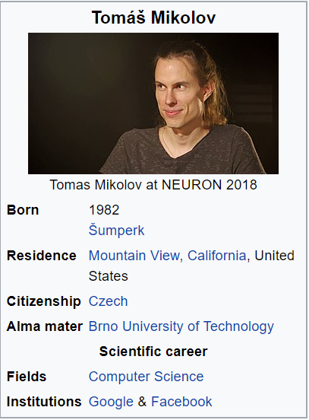
When he was an Intern …
In 2012, Thomas Mikolov, an intern at Microsoft, found a way to encode the meaning of words in a modest number of vector dimensions.
In 2013 (at Google), Mikolov and his teammates released Word2vec.

Slide 3
Word2Vec
He trained a neural network to predict word occurrences near a target word.
The weights of the network help represent words!!
Basically, it is a language modeling problem!!
It is unsupervised learning that the prediction is based on a super large corpus of unlabeled text.
Or … supervised … but the labeling has been done already!!

Slide 4
Two Approaches
Two approaches to train the prediction model:
Skip-gram: predicts the context of words from a word of interest.
Continuous bag-of-words (CBOW): predicts the target word from the nearby words.

Slide 5
Skip-gram Approach (1/9)
In skip-gram, the model is trying to predict the surrounding window of words based on an input word.
The neutral network consists of two layers of weights.
The hidden layer consists of n neurons.
n is the number of vector dimension used to represent a word.
The input and output layers contain m neurons.
m is the number of words in the vocabulary.
Note that the output layer uses softmax as an activation function.
w_{t-2}, w_{t-1} w_{t+1} w_{t+2} : the surrounding words
Claude Monet painted the Grand Canal of venice in 1908.
w_{t}: the input word

Slide 6
Skip-gram Approach (2/9)
The prediction (testing) phase of the model:
Claude
0
0.006
Claude
Monet
0
0.004
Monet
painted
1
0.001
painted
the
0
0.967
the
…
…
…
drew
0
0.001
drew
sketched
0
n hidden neurons
0.001
sketched
m inputs
one-hot vector for words
m outputs

Slide 7
Skip-gram Approach (3/9)
How to train the prediction model?
You need a text corpus.
Suppose the window size of the context is 2.
Process every token in the corpus to produce a set of training word pairs:
Claude Monet painted the Grand Canal of venice in 1908.
input word | expected output word
…
painted | Claude
painted | Monet
painted | the
painted | grand
…

Slide 8
Skip-gram Approach (4/9)
Randomly initialize the network (weights):
Claude
Claude
Monet
Monet
painted
painted
the
the
…
…
…
drew
drew
sketched
n hidden neurons
sketched
W_{mxn}: weight matrix
W’_{nxm}: weight matrix
Randomly initialize the weight matrices

Slide 9
Skip-gram Approach (5/9)
The objective of the model (the weights) is to make a correct prediction of each training word pair!!
Training pair: {painted, the}
Claude
0
0.006
Claude
Claude
0
0.001
Claude
Monet
0
0.004
Monet
Monet
0
0.001
Monet
painted
1
0.001
painted
painted
1
0.002
painted
the
0
0.001
the
the
0
0.983
the
…
…
…
…
…
…
drew
0
0.954
drew
drew
0
0.001
drew
sketched
0
n hidden neurons
0.001
sketched
sketched
0
n hidden neurons
0.001
sketched
m inputs
m outputs
m inputs
m outputs
Bad weights…
Good weights…

Slide 10
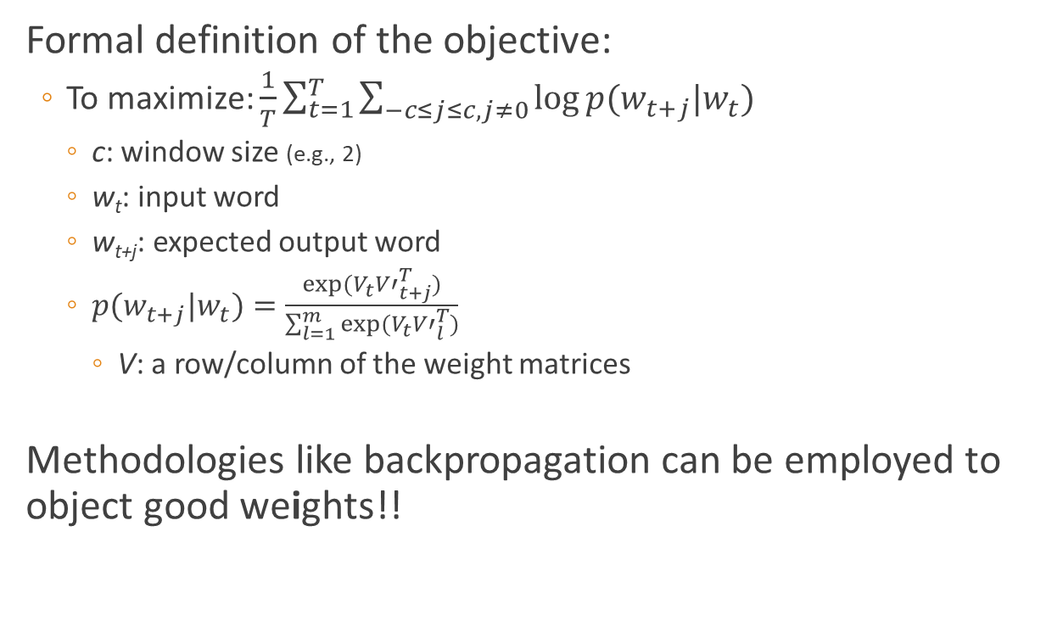
Skip-gram Approach (6/9)
Formal definition of the objective:
To maximize: $\frac{1}{T}\sum_{t=1}^{T}{\sum_{−c≤j≤c,j≠0}{log⁡p(w_{t+j}|w_{t})}}$
c: window size (e.g., 2)
w_{t}: input word
w_{t+j}: expected output word
$p(w_{t+j}|w_{t})=\frac{exp⁡(V_{t}{V′}_{t+j}^{T})}{\sum_{l=1}^{m}{exp⁡(V_{t}{V′}_{l}^{T})}}$
V: a row/column of the weight matrices
Methodologies like backpropagation can be employed to object good weights!!

Slide 11
Skip-gram Approach (7/9)
After training, the weight matrix W consists of word embedding.
Claude
Claude
Monet
Monet
painted
painted
the
the
WHY?
…
…
…
drew
drew
Every word now can be
represented as a n-dim
embedding vector!!
sketched
n hidden neurons
sketched
W_{mxn}: weight matrix
Claude
0.3 | 0.07 | -0.02 | … | 0.61
Monet
painted
…

Slide 12
Skip-gram Approach (8/9)
The prediction is like a function!!
Claude
0
0
Claude
T
T
0.3
0.07
-0.02
…
0.61
0
0
0
1
…
0
0
0.3
Monet
0
0
Monet
0.07
W’
=
painted
1
0
painted
the
0
-0.02
1
the
…
…
…
input’s embedding
drew
0
0.61
0
drew
sketched
0
n hidden neurons
0
sketched
W_{mxn}: weight matrix
Claude
0.3 | 0.07 | -0.02 | … | 0.61
Monet
painted
…

Slide 13
Skip-gram Approach (9/9)
Semantically similar words (synonyms) will produce similar embeddings!!
Because they were trained to predict similar surrounding words!!
Or … they form similar training pairs!!
Training dataset: {painted, Claude} {painted Monet} …
{sketched, Claude} {sketched, Monet} …
painted’s embedding
0.3
0.07
-0.02
1
0
0
0
…
0
0
W’
=
0.28
0.05
-0.04
?
?
?
What about sketched’s embedding?

Slide 14
CBOW
Predict the center word based on the surrounding words.
Claude
1
0.003
Claude
Monet
1
0.001
Monet
painted
0
0.952
painted
the
1
0.001
the
Grand
1
…
…
0.001
drew
…
sketched
0
n hidden neurons
0.001
sketched
m inputs
multi-hot vector for words
m outputs

Slide 15
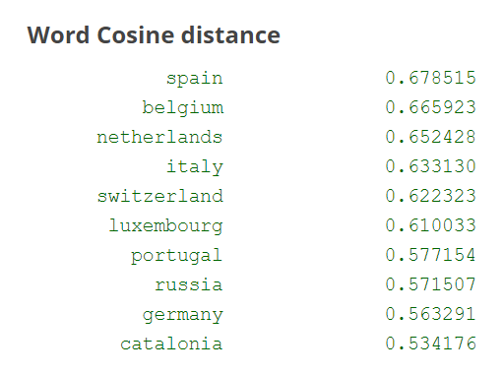
Use of Embeddings
1. Find close words
Cosine similarity of vectors.
Words close to “France”
2. Reasoning the relationships between words
V_{San_Francisco} – V_{california} + V_{colorado} = V_{Denver}
V_{king} – V_{man} + V_{woman} = V_{queen}
3. Inputs of sophisticate deep learning networks
Example provided by Google word2vec project

Slide 16
Which Approach is Better?
Mikolov highlighted:
Skip-gram works well with small corpora and rare terms.
CBOW shows higher accuracies for frequent words and is much faster to train.
Some studies show skip-gram is better…

Slide 17
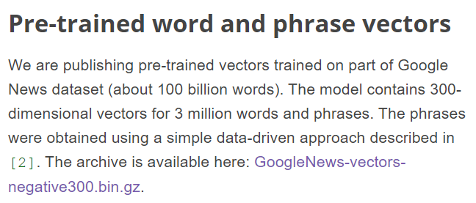
Pretrained Vectors
The computation of the word vectors can be resource intensive!!
Luckily, for most applications, you won’t need to compute your own word vectors.
Google provides a pretrained Word2vec vector set based on English Google News articles.
https://code.google.com/archive/p/word2vec/
Facebook published pretrained fastText models for 294 languages!!
But if your application relies on specialized vocabulary, you will need to train word vectors on text from your application domain.
Download it before you use it!!

Slide 18
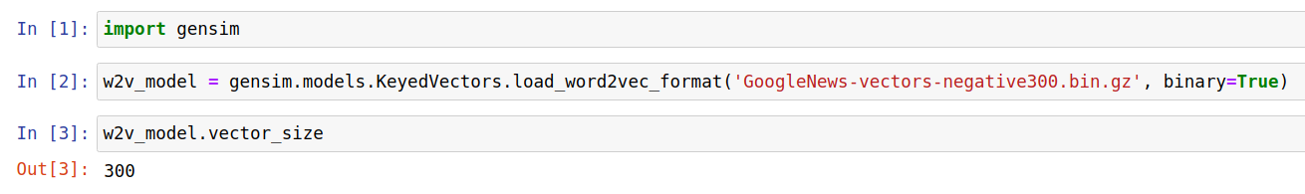
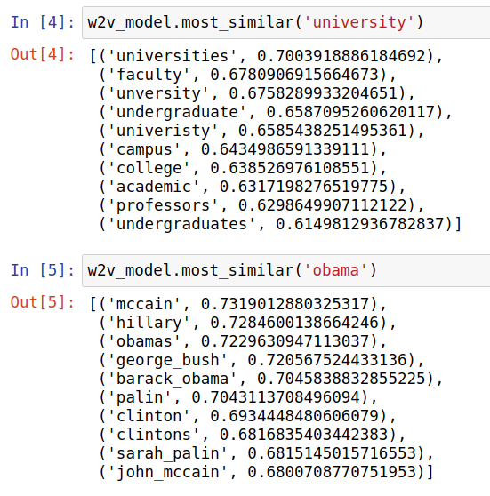
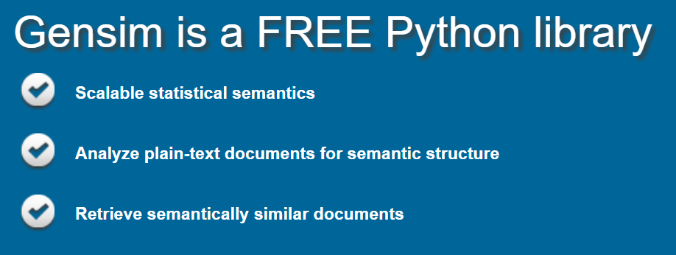
Word2Vec Practice (1/2)
Notes:
conda install -c conda-forge genism
Sometimes you need
conda install smart_open==2.0.0
The below commands work.
brew install wget wget -c "https://s3.amazonaws.com/dl4j-distribution/GoogleNews-vectors-negative300.bin.gz"
You can then use the below command to get wordVector.
from gensim import models w = models.KeyedVectors.load_word2vec_format( '../GoogleNews-vectors-negative300.bin', binary=True)

Slide 19
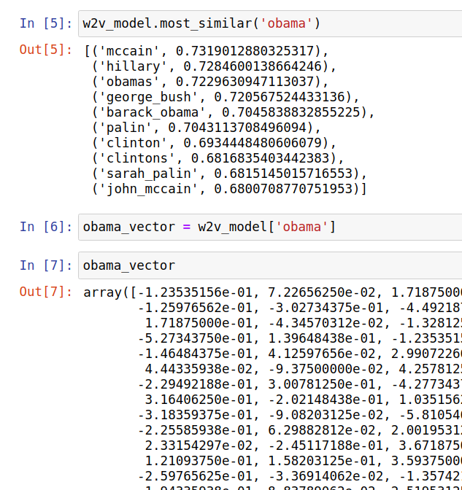
Word2Vec Practice (2/2)
Inputs of sophisticate deep learning networks
Once upon a time, …
once
1.34
…
0.291
upon
-2.17
…
1.85
a
-1.79
…
-0.66
…
Recurrent NN
output
…

Slide 20
BERT and Transformers
Reference:
https://towardsdatascience.com/transformers-state-of-the-art-natural-language-processing-1d84c4c7462b
http://jalammar.github.io/illustrated-transformer/

Slide 21

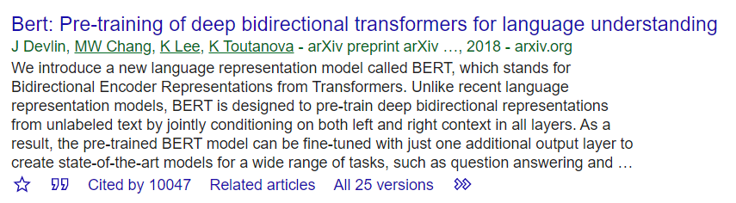
BERT - Transformer
BERT – Bidirectional Encoder Representations from Transformers
A well-known word embedding method, broke several records of natural language processing contests.
The pre-trained model was released in 2018
https://github.com/google-research/bert

Slide 22
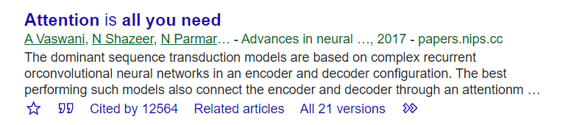
Transformer (1/2)
Transformer is designed to handle sequential data, especially natural languages.
It is based on the encoder-decoder architecture enhanced with the attention mechanism.

Slide 23
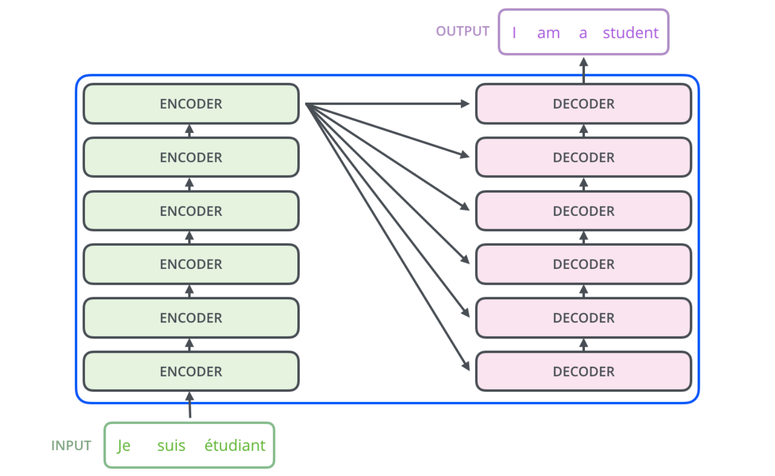
Transformer (2/2)
Encoder: to extract important features from data – code
To compress, remove noisy information of data
Or … to produce meaningful representation (vector) of the given data.
Decoder: to restore data (to generate correct data) from the code of the data
Not new, but attention takes it to another level!!
http://jalammar.github.io/illustrated-transformer/

Slide 24
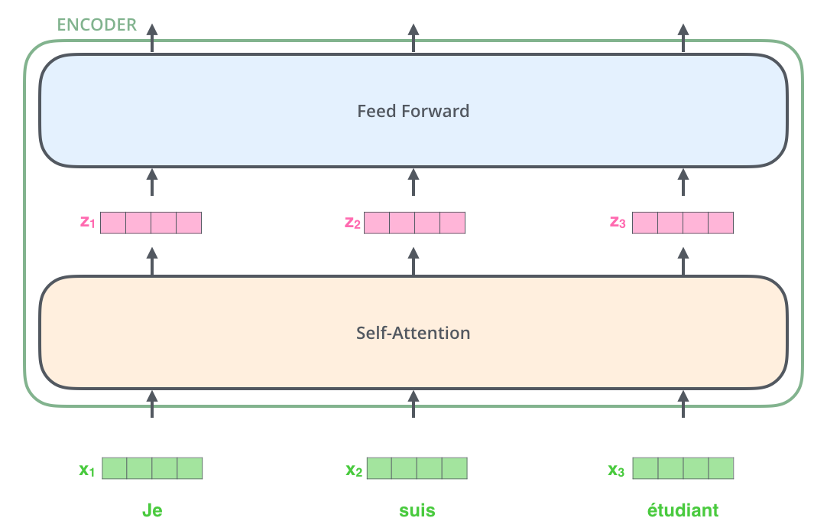
Encoder
The inputs first flow through a self-attention layer
A layer that helps the encoder look at other words in the input sentence as it encodes a specific word.
The feed-forward neural network generates an output for each z_{i} and the output from the feed-forward neural network is passed into the next encoder block’s self-attention layer and so on.
Each input token is first represented as a embedding

Slide 25
Self-Attention (1/8)
Think about this:
“The animal didn’t cross the street because it was too tired”
it refers animal, so the code of it should include the information (code) of animal!!
For an input embedding x, attention generates three meta-outputs:
Query: q_{x}
Key: k_{x}
Value: v_{x}

Slide 26
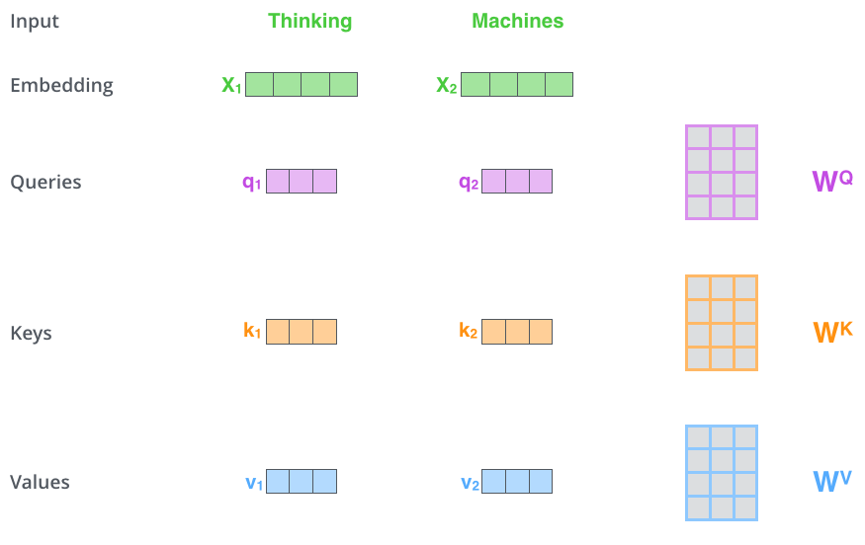
Self-Attention (2/8)
The matrices are learning parameters

Slide 27
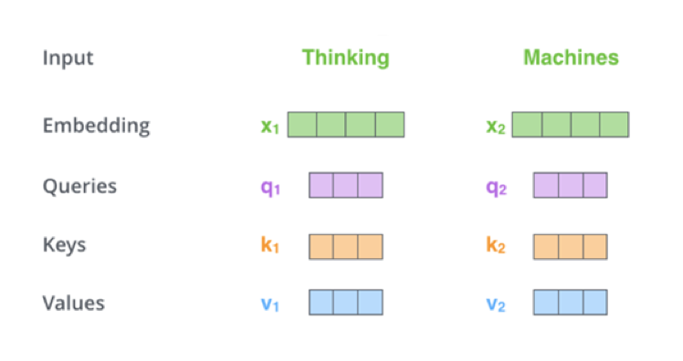
Self-Attention (3/8)
After having the 3 meta-outputs Q, K, and V of ALL input embeddings
The self-attention layer calculates a score vector for each input embedding.
Which is used to aggregated the input embedding’s output
q₁k₁=112
q₁k₂=96
q₂k₁=64
q₂k₂=109

Slide 28
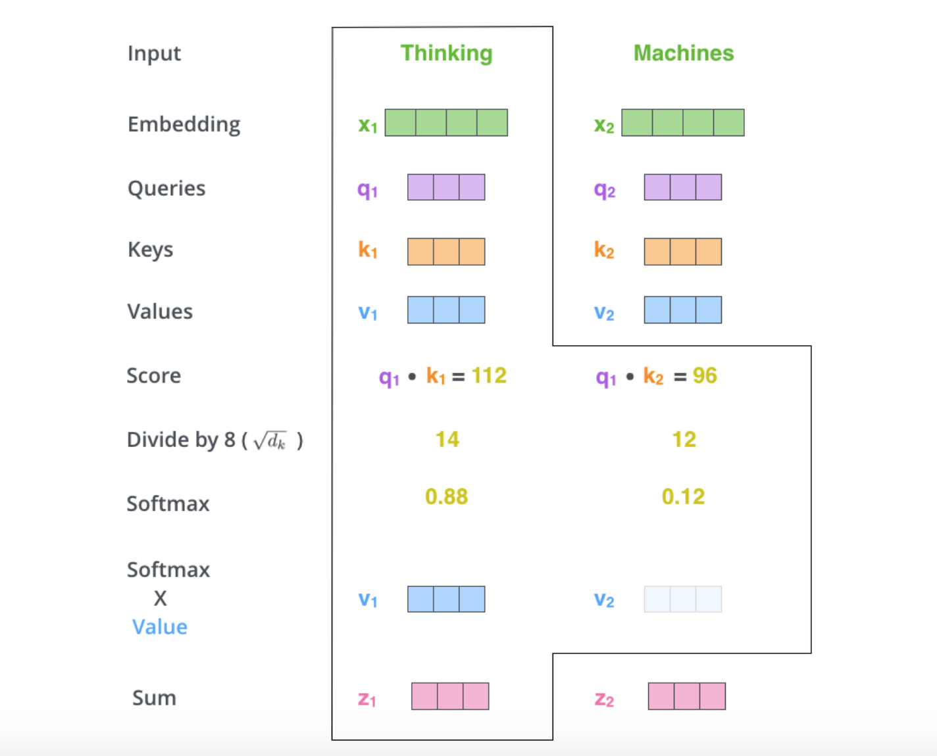
Self-Attention (4/8)
This way, the z (meta-code) of each input is the weighted combination of all values (all information of the input tokens)

Slide 29
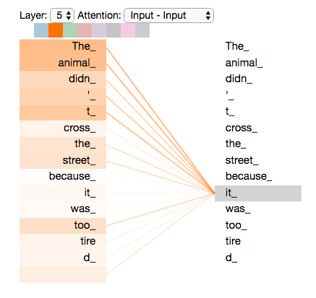
Self-Attention (5/8)
The scores show that The and animal contribute a lot to the output of it
http://jalammar.github.io/illustrated-transformer/

Slide 30
Self-Attention (6/8)
Multi-head:
A single attention-head could miss some of the words in input that contribute most to the spotlight word.
Instead of using a single attention-head, multiple attention-heads are employed.
Each attention-head has its own learning parameters: W^{Q}, W^{K}, and W^{V}.
In practice, attention models typically uses 8 attention heads!!
So EACH encoder has 8 sets of learning parameters.
Each attention-head produces a z_{x} that we need to aggregate them all to produce the final output!!
Notes:
Notice that these new vectors are smaller in dimension than the embedding vector. Their dimensionality is 64, while the embedding and encoder input/output vectors have dimensionality of 512. They don’t HAVE to be smaller, this is an architecture choice to make the computation of multiheaded attention (mostly) constant.
64 外加上 8 個 head, concate 成 512的output 再過一個fully-connected NN

Slide 31
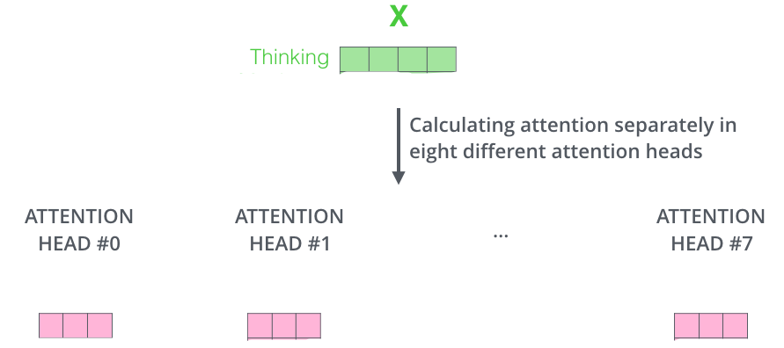
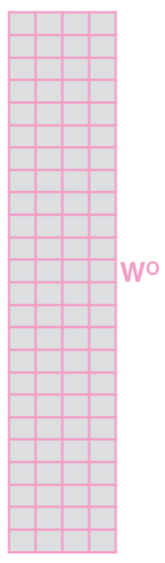
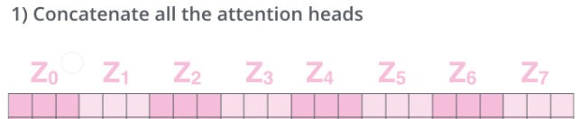

Self-Attention (7/8)
Another learning parameter for each encoder
z_{x}¹
z_{x}⁷
The x’s output of the multi-head attention layer
z_{x}⁰
z_{x}¹
z_{x}²
z_{x}³
z_{x}⁴
z_{x}⁵
z_{x}⁶
z_{x}⁷
z_{x}
x
=

Slide 32
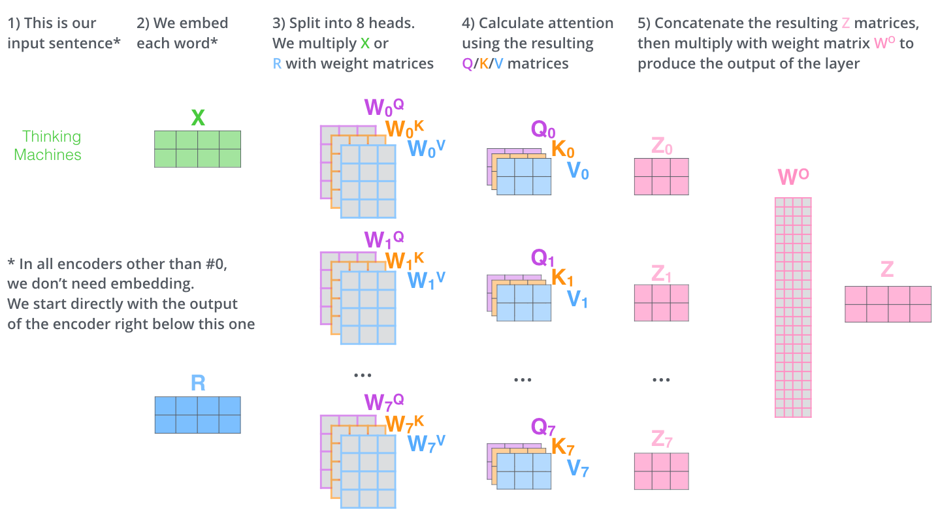
Self-Attention (8/8)
http://jalammar.github.io/illustrated-transformer/

Slide 33
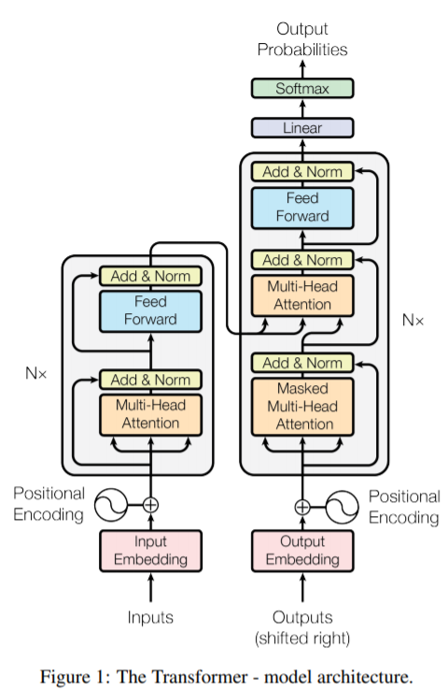
The Whole Picture of Transformer
Other components:
Positional encoding
Add & normalization
Decoder
We are not going to the detail
of these components
but back to BERT

Slide 34
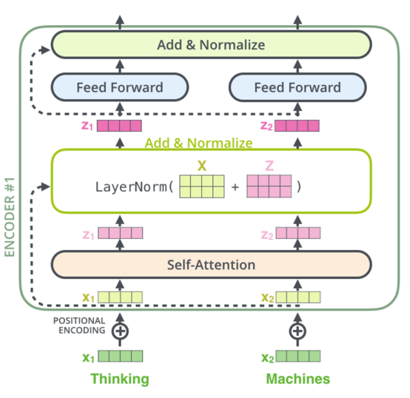
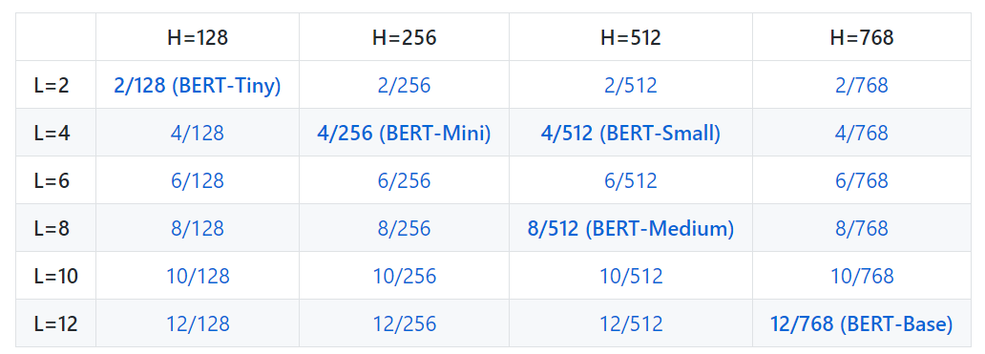
BERT
In BERT, only the encoder part of the transformer is used.
With multi-heads of self-attention, add & norm, feed forward network, and positional encoding.
https://github.com/google-research/bert
BERT-Large: 24-layer, 1024-hidden, 16-heads
BERT-Base Multilingual: 102 languages
BERT-BASE Chinese: Traditional and Simple
http://jalammar.github.io/illustrated-bert/

Slide 35
BERT vs Word2Vec
BERT generates the embedding of a word by considering ALL the words of the input sentence simultaneously.
By means of the attention mechanism.
The embeddings of Word2Vec are context-independent!!
“the game will lead to a tie if both the guys tie their final tie at the same time.”
Word2vec would give the three tie the same embedding while each tie‘s embedding in BERT will be different.
Because BERT is context-dependent, we need the pre-trained model every time while generating the embeddings of words.
Word2Vec: we simply copy and use the trained vectors.

Slide 36
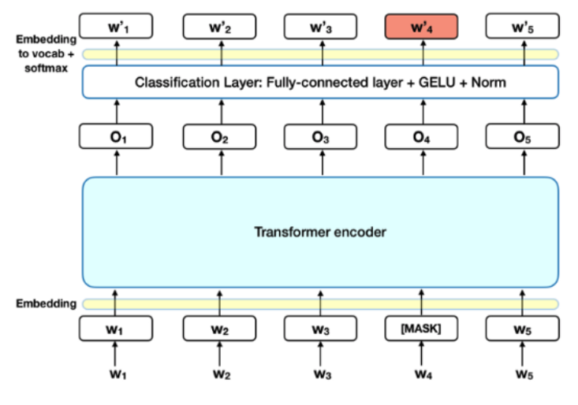
How do THEY train the models
BERT was pre-trained on a large corpus of un-labelled text including the entire Wikipedia(that’s 2,500 million words) and book corpus (800 million words).
Two training methods:
Unmasked language model
to predict the masked words correctly given the context of unmasked words.
Next sentence prediction
to predict the order of the two sentences. Return 1 if the first sentence comes after the second sentence and 0 otherwise

Slide 37
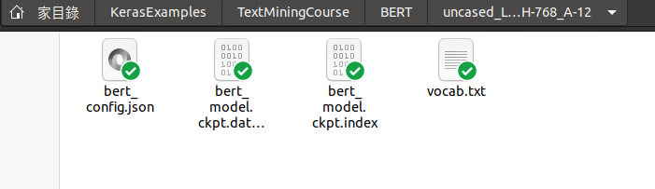
How do We use the models (1/6)
First, download one of the pre-trained models
https://github.com/google-research/bert
The zip file contains three item:
Checkpoint file: the pre-trained weights
Vocab file: dictionary and word id
Config file: hyper-parameters
Then, choose a library
Here, we take keras-bert as an example
https://github.com/CyberZHG/keras-bert
To install the library: pip install keras-bert
Do not forget where you put the files

Slide 38
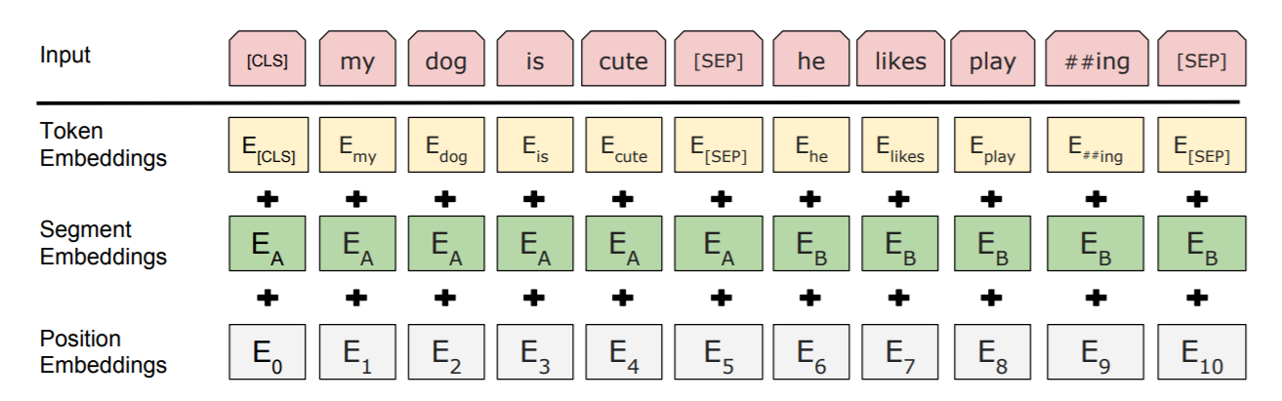
How do We use the models (2/6)
Single text task or text pair task:
Single text task – e.g., to classify a given text is a spam or not.
Text pair task – e.g., to classify a given question-answer pair is relevant or not.
BERT takes 3 types of input: token embeddings, segment embeddings, and positional embeddings
example of a single text
example of a text pair

Slide 39
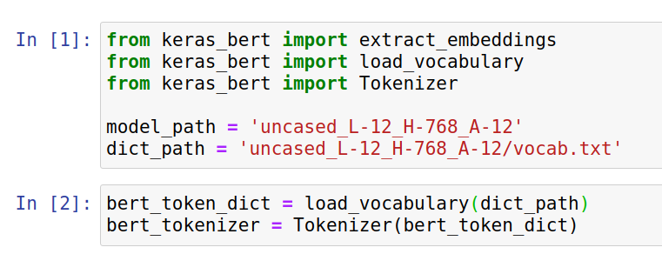
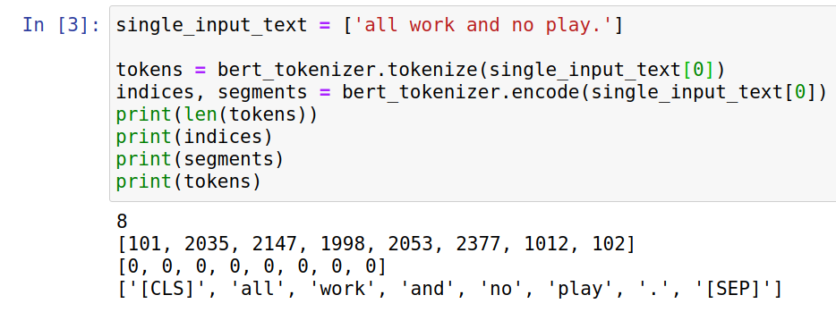
How do We use the models (3/6)

Slide 40
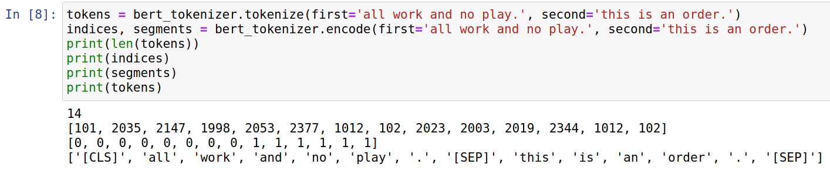
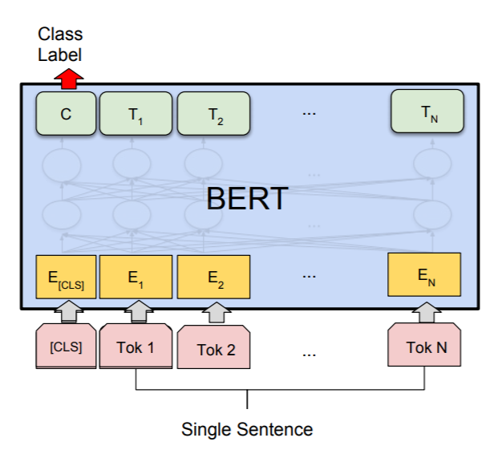
How do We use the models (4/6)
Once the inputs are ready, we pass them to the pre-trained model to output all (including [CLS] and [SEP]) their embeddings!!
Usually, we do not need all the embeddings.
We only keep (use) the embedding of the first [CLS] token.
The embedding aggregates the information (context) of the input text.
We then pass the embedding to the downstream task.
E.g., a feed-forward network for spam classification.

Slide 41
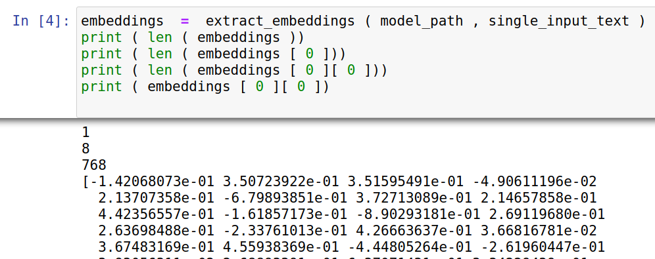
How do We use the models (5/6)

Slide 42
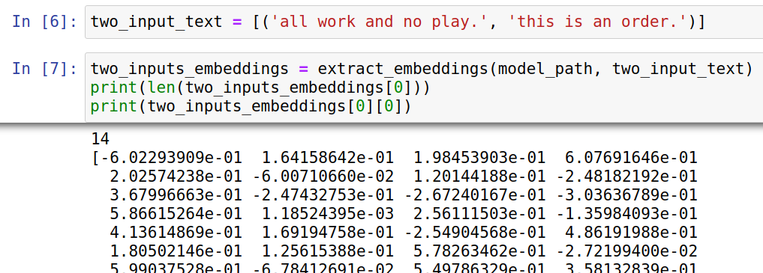
How do We use the models (6/6)
Notes:
Fine tuning example:
https://www.mdeditor.tw/pl/2Xu7/zh-tw
bert_model = load_trained_model_from_checkpoint(config_path, checkpoint_path) for l in bert_model.layers: l.trainable = True x1_in = Input(shape=(None,)) x2_in = Input(shape=(None,)) x = bert_model([x1_in, x2_in]) x = Lambda(lambda x: x[:, 0])(x) # 取出[CLS]對應的向量用來做分類 p = Dense(1, activation='sigmoid')(x) model = Model([x1_in, x2_in], p) model.compile( loss='binary_crossentropy', optimizer=Adam(1e-5), # 用足夠小的學習率 metrics=['accuracy'] ) model.summary()

Slide 43
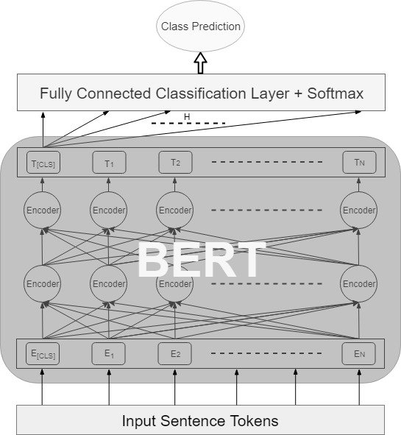
Pre-training and Fine Tuning
Not just inputting the embedding of [CLS] to downstream task, you can connect BERT with downstream networks!!
For example, connect BERT with a fully connected classification layer
That is what we called “end-to-end” model!!
The training process will not only learn the weights of the classification layer, but also tune the weights of BERT (e.g., W^{Q}, W^{K}, and W^{V}).
You customize BERT to your tasks (rather than using a generalized pre-trained model).
Note that fine tuning such end-to-end model would be time (memory) consuming.
BERT-Base, Multilingual Cased: 104 languages, 12-layer, 768-hidden, 12-heads, 110M parameters
BERT-Large, Uncased (Whole Word Masking): 24-layer, 1024-hidden, 16-heads, 340M parameters

